Slide 1
20240913 Condensed matter physics: from magnetism to quantum spin liquid I
Sophia University Ryui Kaneko （金子隆威）

Slide 2
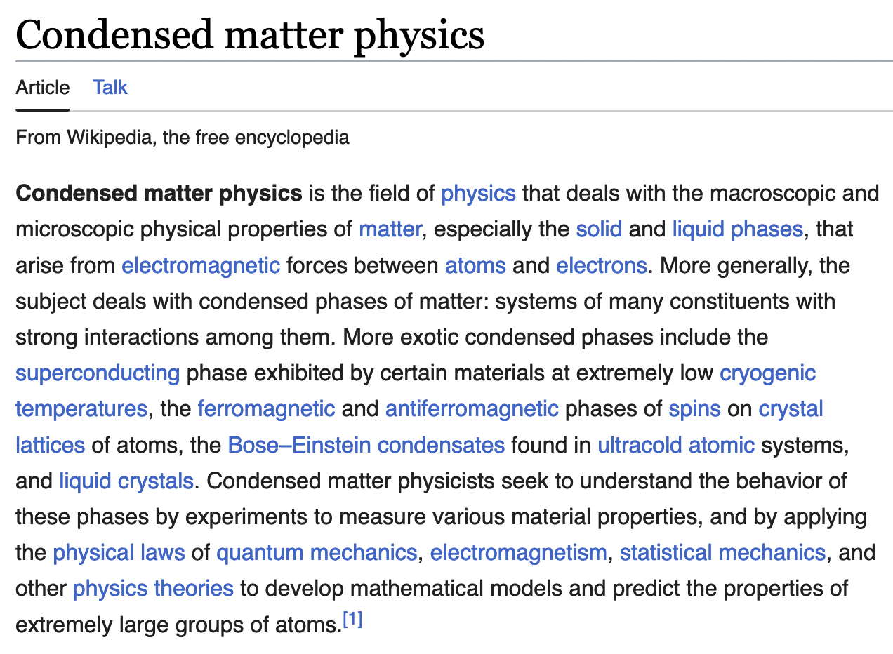
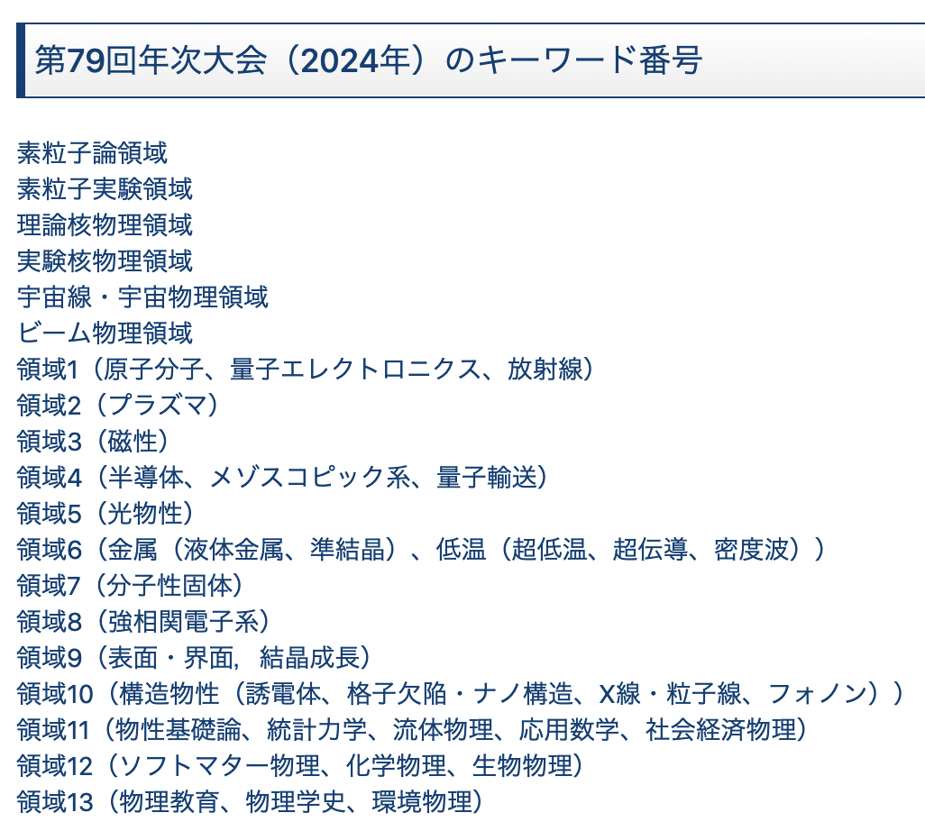
What is condensed matter physics?
凝縮系物理、固体物理、物性物理、… in Japanese
Focus on magnetism today and tomorrow
From Wikipedia
From JPS meeting （日本物理学会）
atom, molecular, optical physics
magnetism
semiconductor
metal
superconductor, density wave
strongly correlated electron systems
statistical mechanics

Slide 3
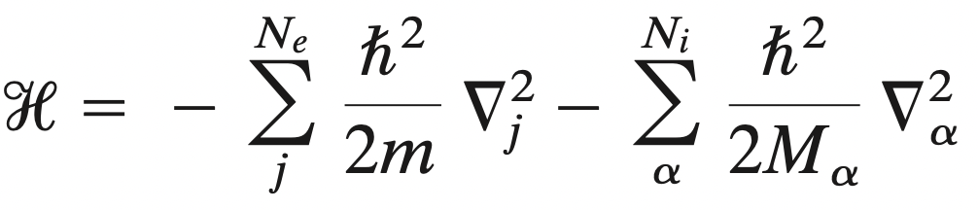
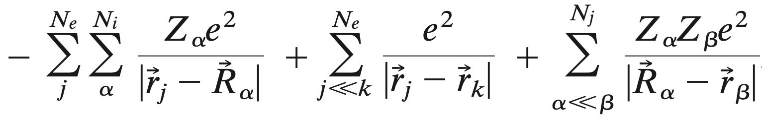
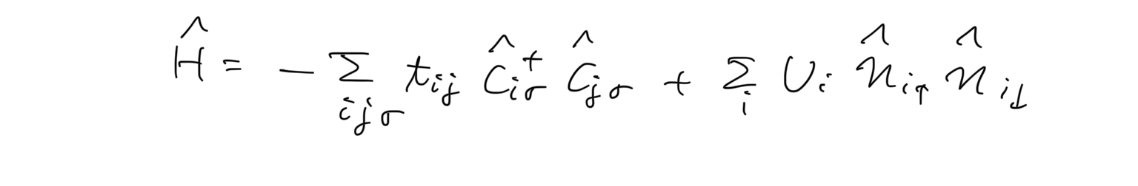
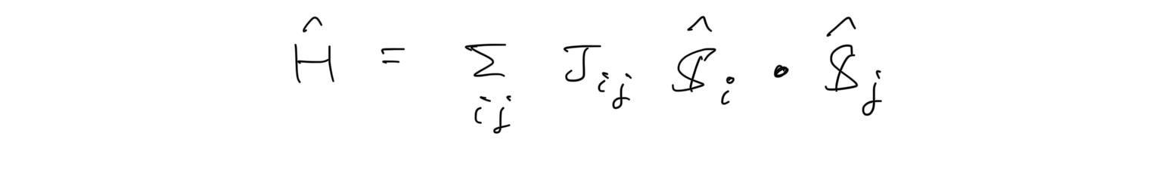
Rough outline
Hamiltonian for electrons in atoms
Hubbard model
Heisenberg model
magnetism, quantum spin liquid, …

Slide 4
Outline
Brief review of itinerant electron systems
Electrons in crystals
Second quantization
Hubbard models
Solving models for simple cases
Noninteracting and atomic limits
Mean-field approximation
Exact diagonalization (2 sites)
→ Strong coupling limit: Heisenberg model (spin system)
Magnetism and quantum spin liquid
Spin models
Frustrated magnetism and quantum spin liquid
Kitaev honeycomb spin liquid

Slide 5
Rough outline
Hamiltonian for electrons in atoms
Second quantization
Hubbard model
Heisenberg model
magnetism, quantum spin liquid, …

Slide 6
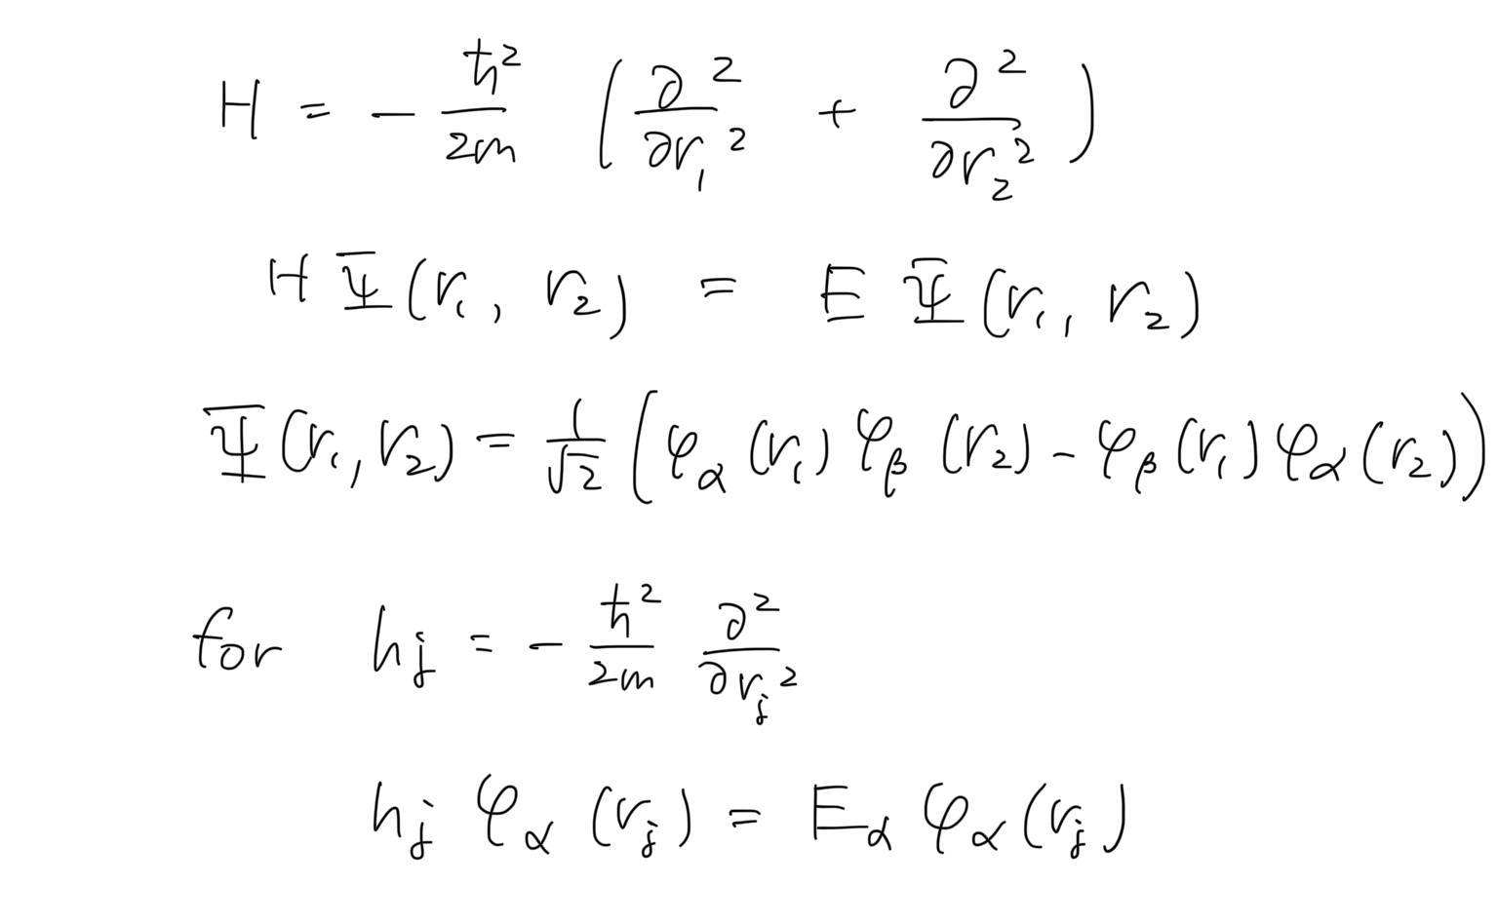
For simplicity, consider 2 free electrons
Solve the eigenvalue problem and antisymmetrize the wave function for fermion
φ_{α}(r) is defined as

Slide 7
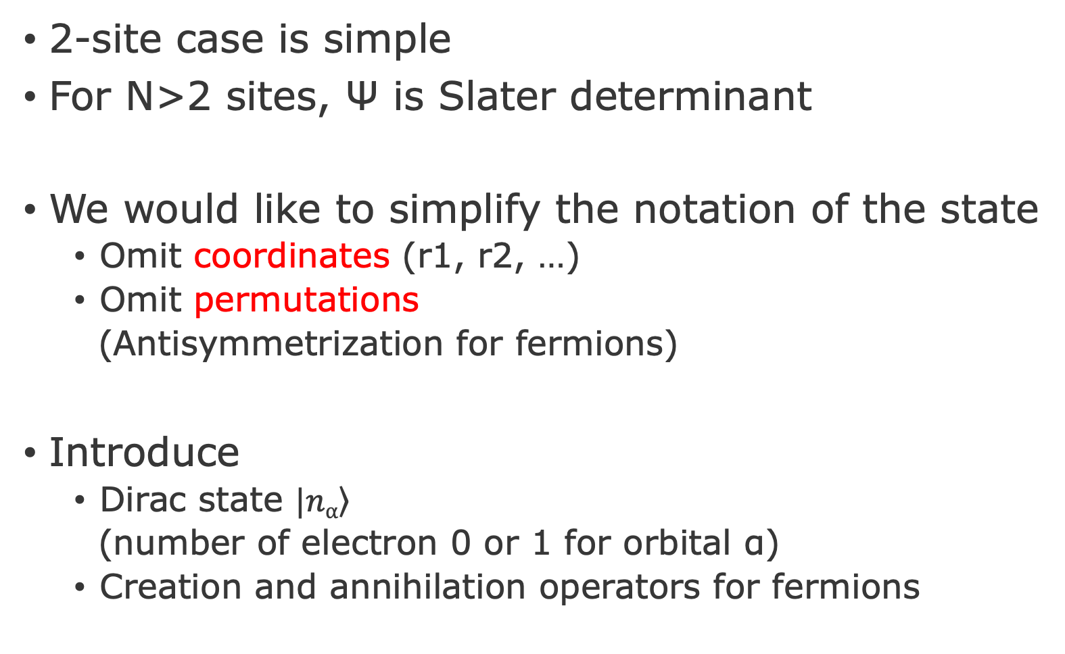
Motivation: Simplify the notation
2-site case is simple
For N>2 sites, Ψ is Slater determinant
We would like to simplify the notation of the state
Omit coordinates (r1, r2, …)
Omit permutations
(Antisymmetrization for fermions)
Introduce
Dirac state $\left.|nα\right\rangle$
(number of electron 0 or 1 for orbital α)
Creation and annihilation operators for fermions

Slide 8
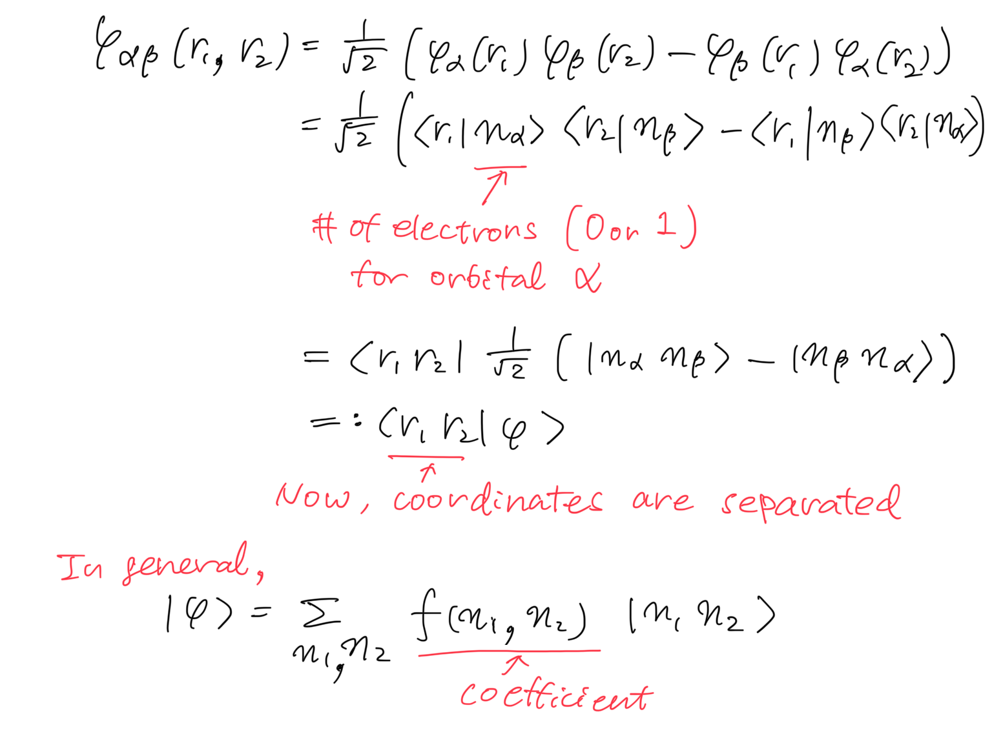
Remove coordinate

Slide 9
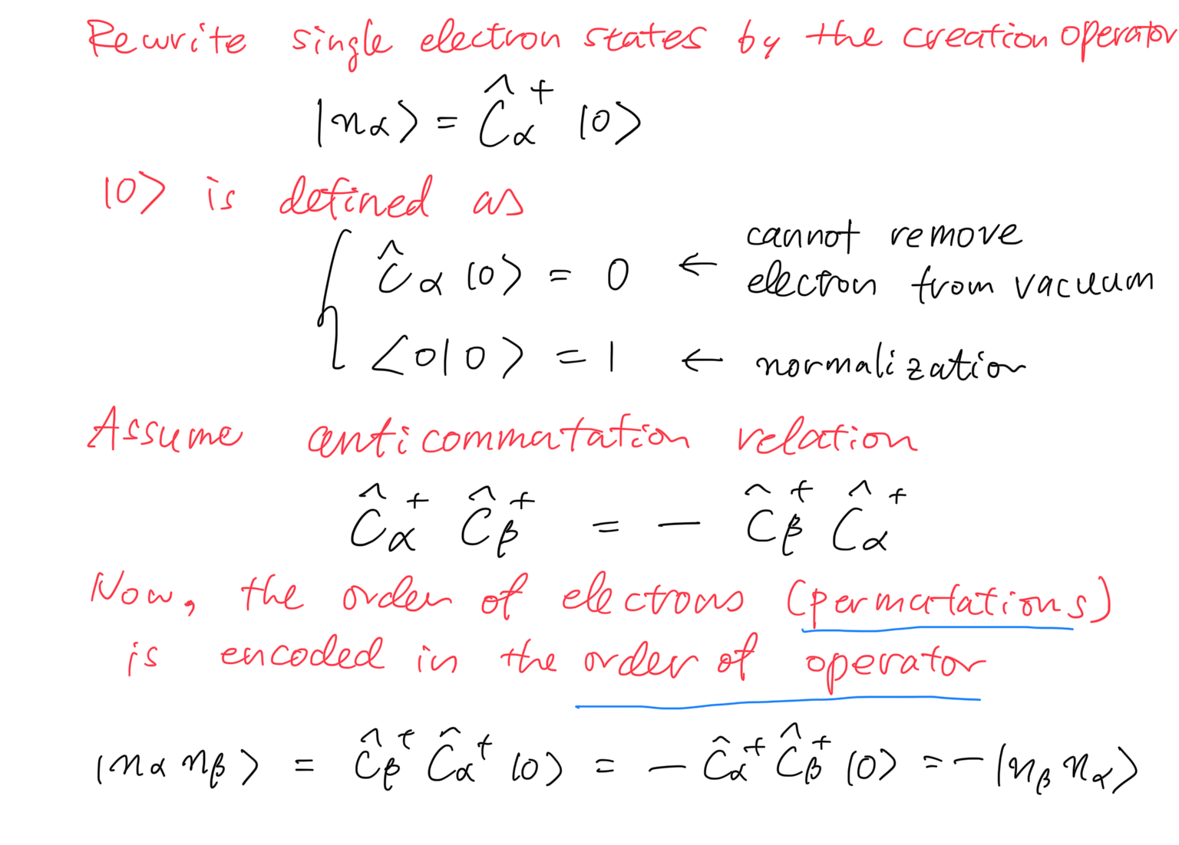
Permutation → Commutator

Slide 10
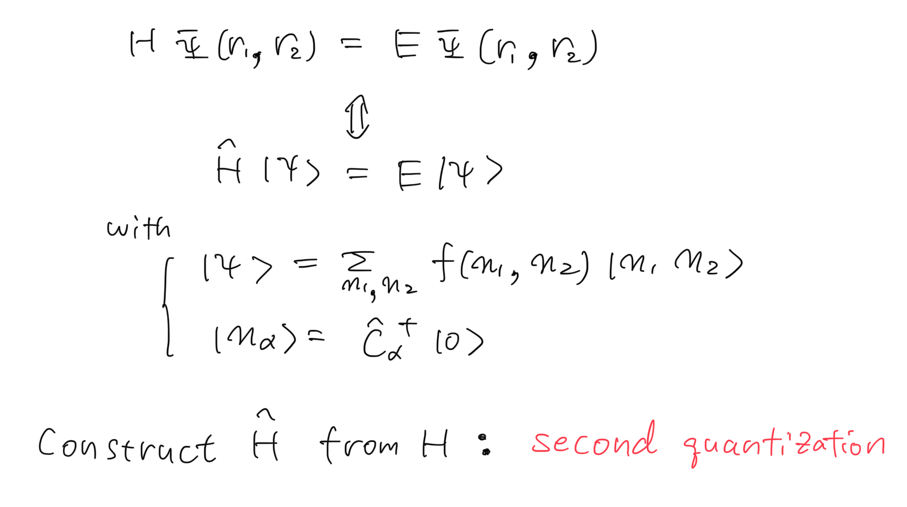
Construct operator $\hat{H}$ from H
But how?

Slide 11
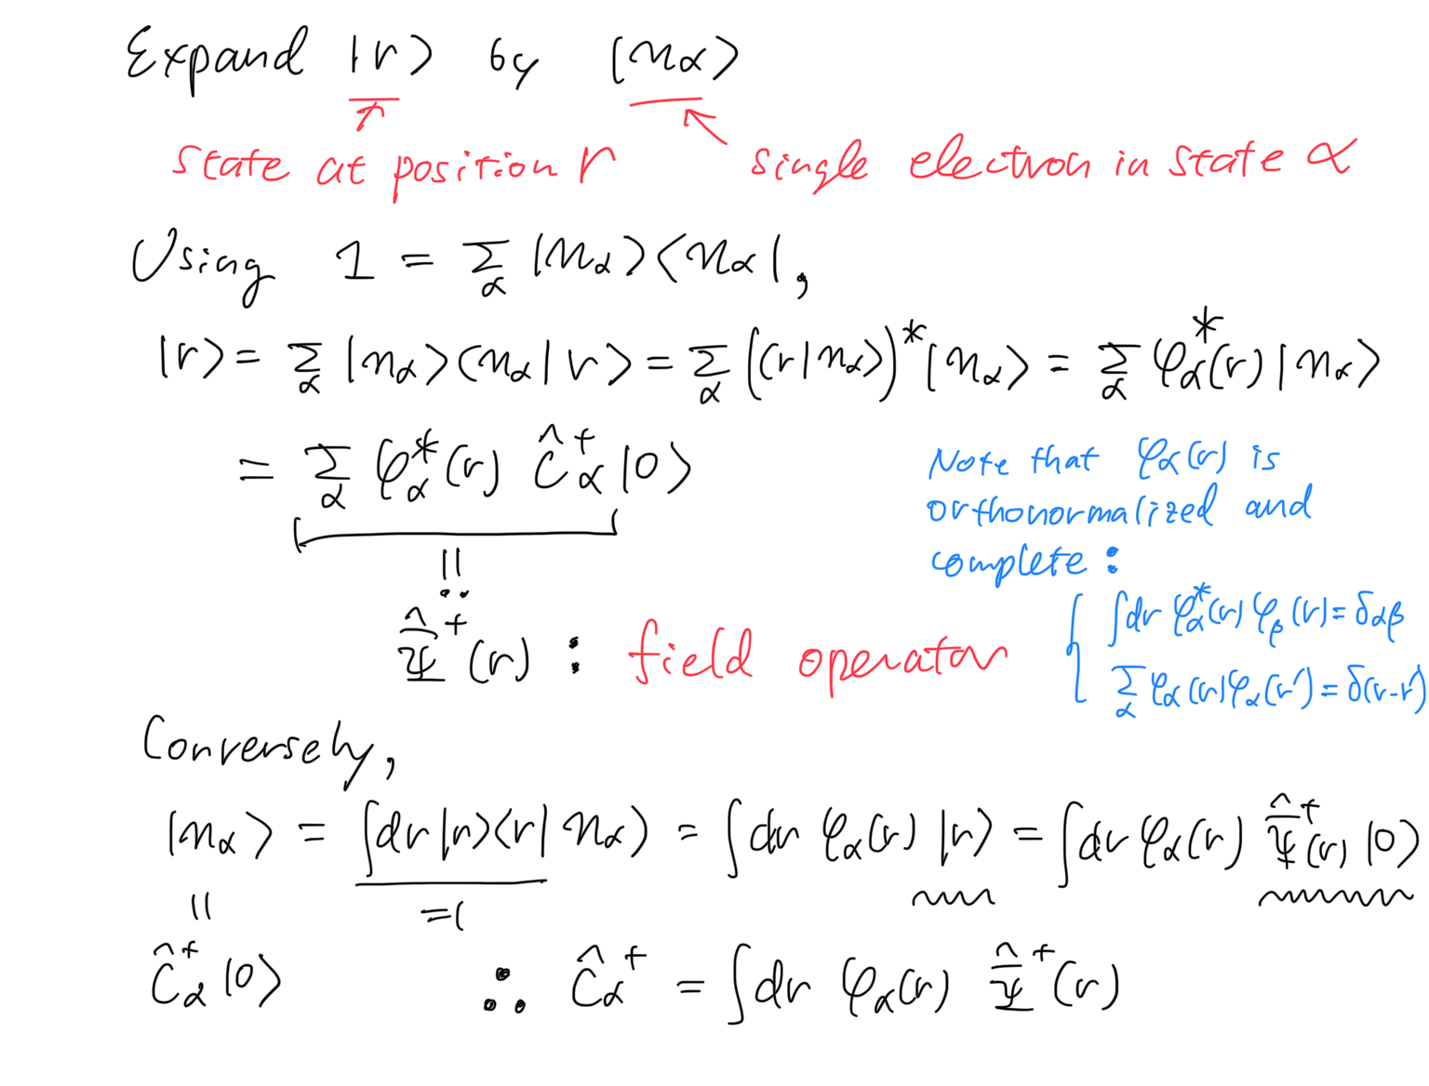
Preparation: Introduce field operator

Slide 12
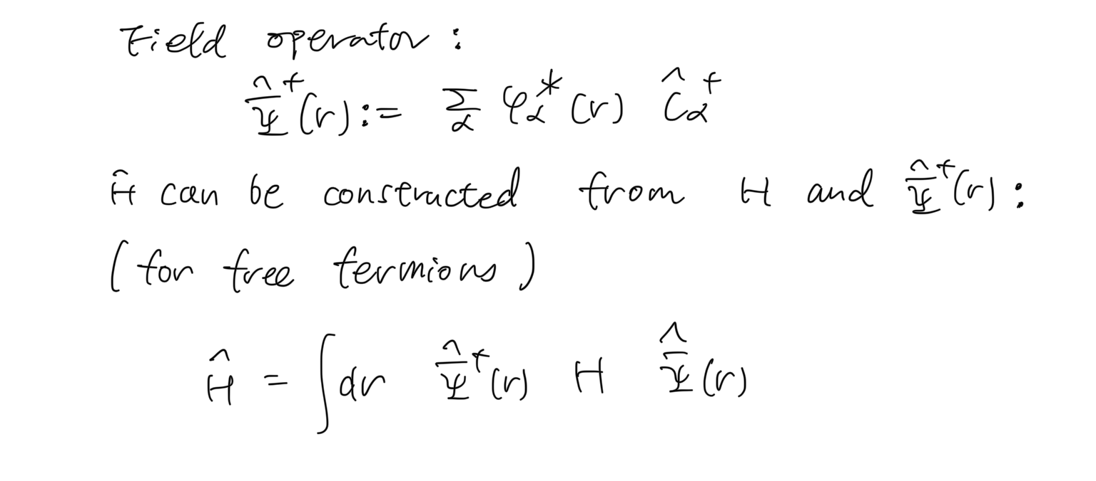
Second quantized Hamiltonian

Slide 13
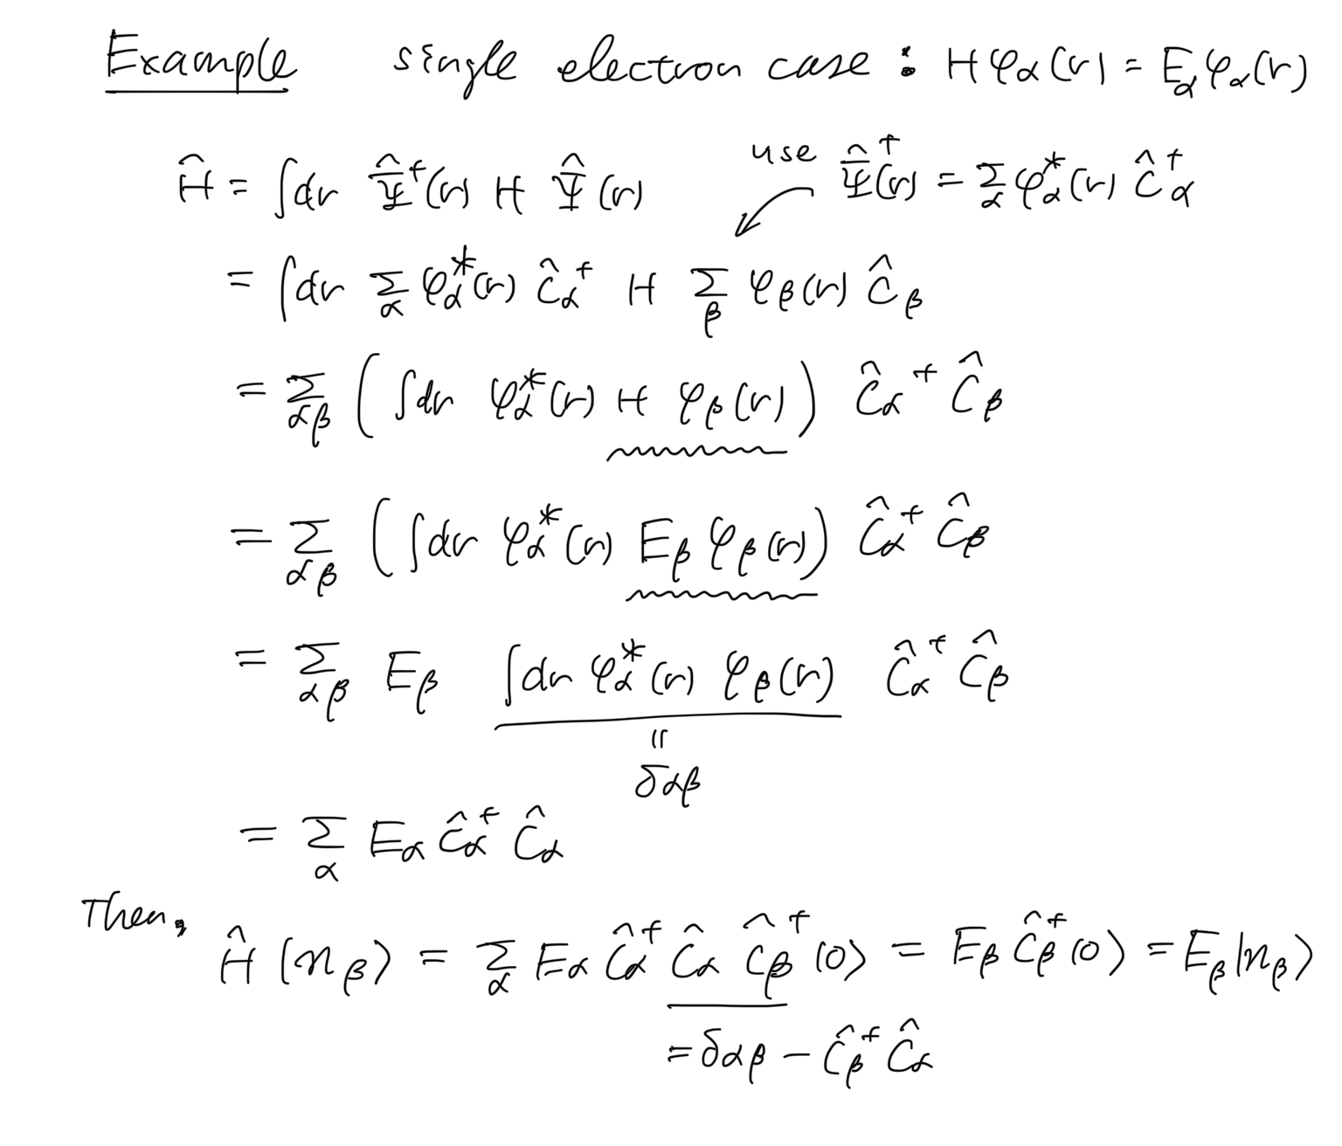
Check by taking an example

Slide 14
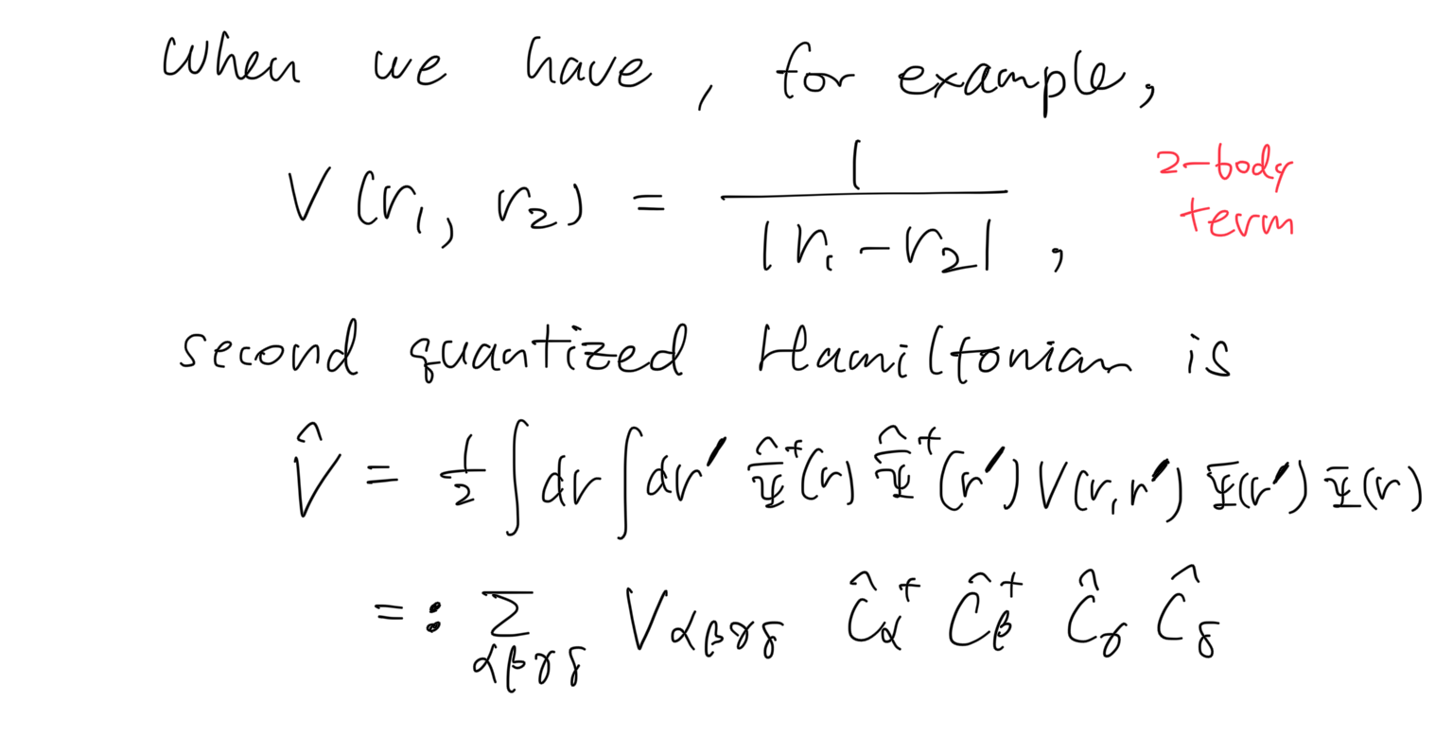
Second quantize 2-body interaction

Slide 15
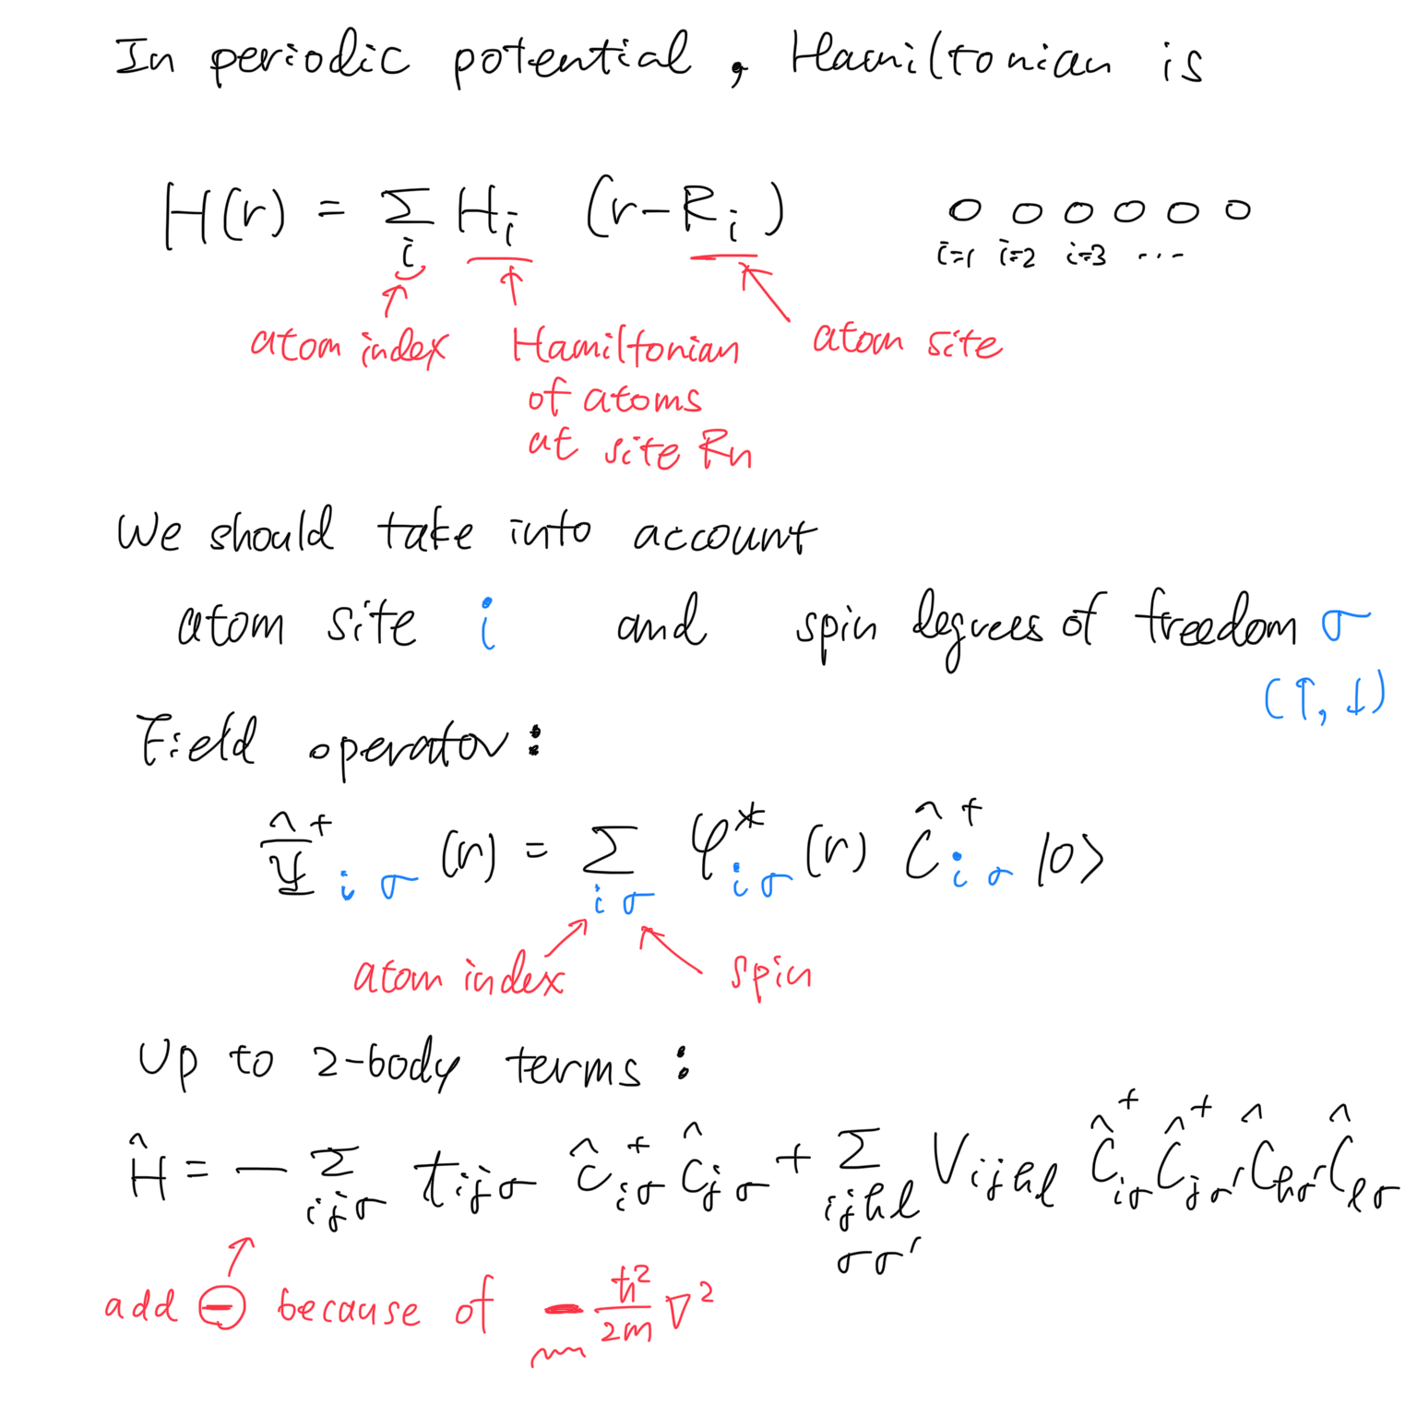
Hamiltonian in crystals

Slide 16
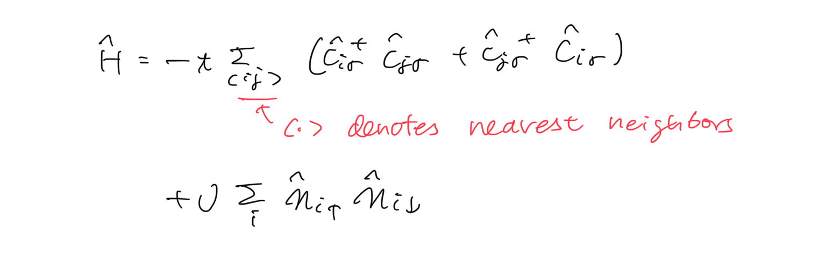
Further simplification → Hubbard model
To further simplify the model, consider
Nearest neighbor i,j for t_{ij}
→ t_{ij}=:t for |i-j|=1
Onsite i,j,k,l for V_{ijkl}
→ V_{iiii}=:U
We finally obtain the Hubbard model

Slide 17
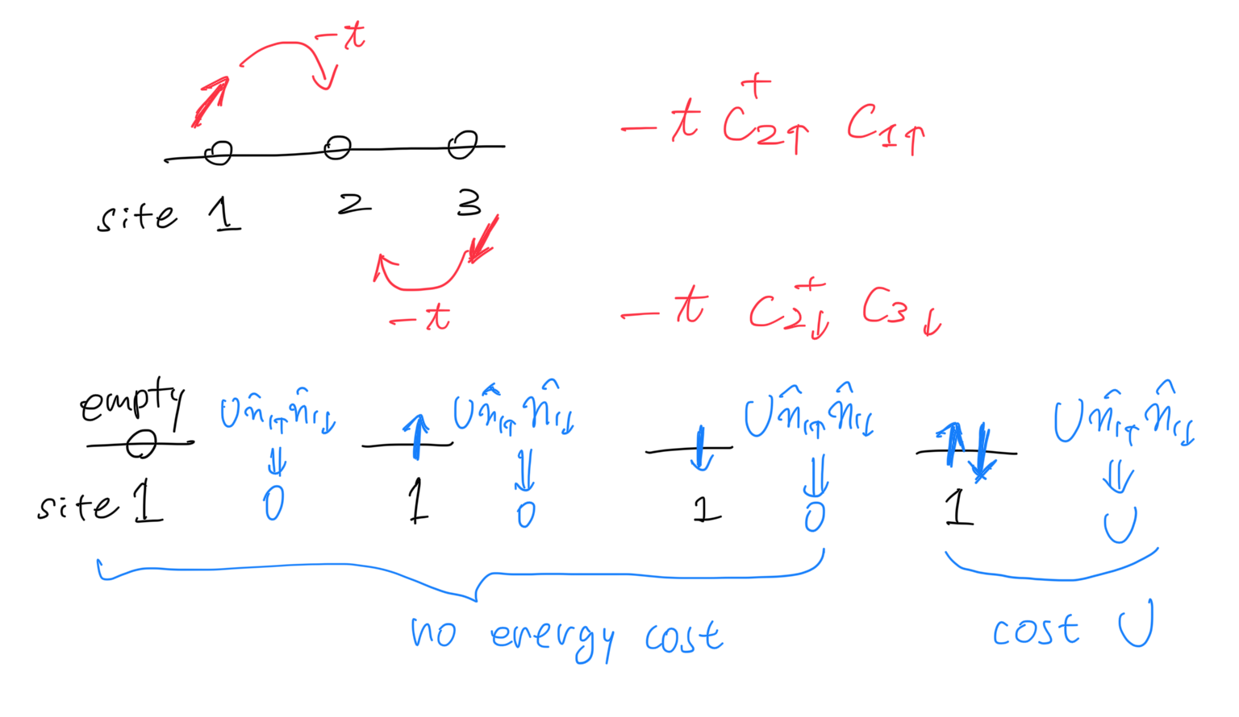
Hubbard model

Slide 18
Rough outline
Hamiltonian for electrons in atoms
Hubbard model
Heisenberg model
magnetism, quantum spin liquid, …

Slide 19
Several limits / Solve by approximation
U=0 limit (noninteracting limit)
Tight-bonding model, free fermion system
t=0 limit
Atomic limit
Mean-field approximation
Antiferromagnetic order for bipartite lattices
2-site model
Relation to the spin model (Heisenberg model)

Slide 20
Several limits / Solve by approximation
U=0 limit (noninteracting limit)
Tight-bonding model, free fermion system
t=0 limit
Atomic limit
Mean-field approximation
Antiferromagnetic order for bipartite lattices
2-site model
Relation to the spin model (Heisenberg model)

Slide 21
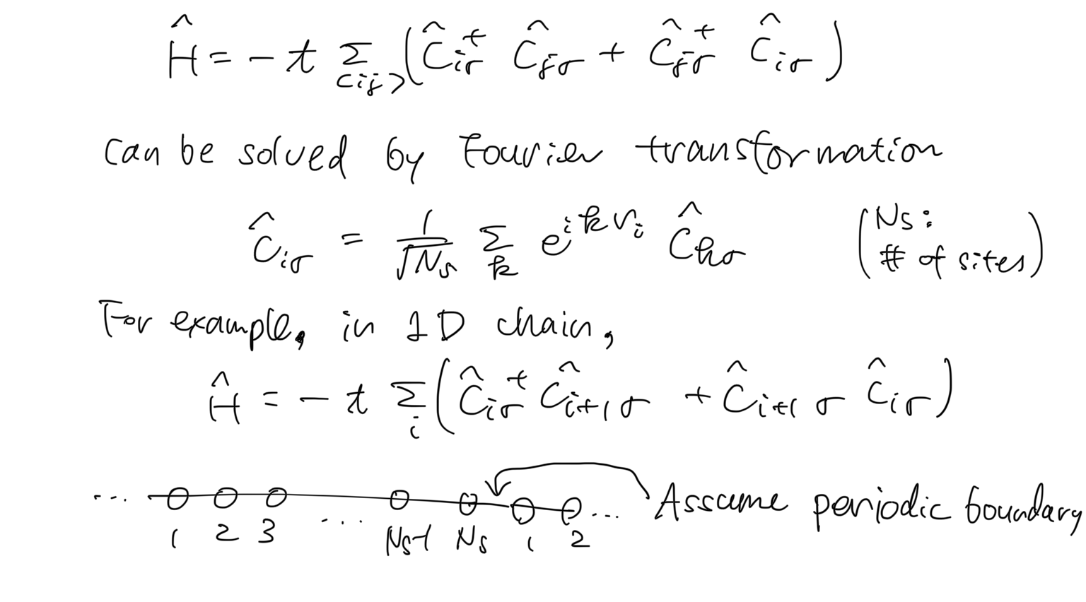
Noninteracting limit (U=0)

Slide 22
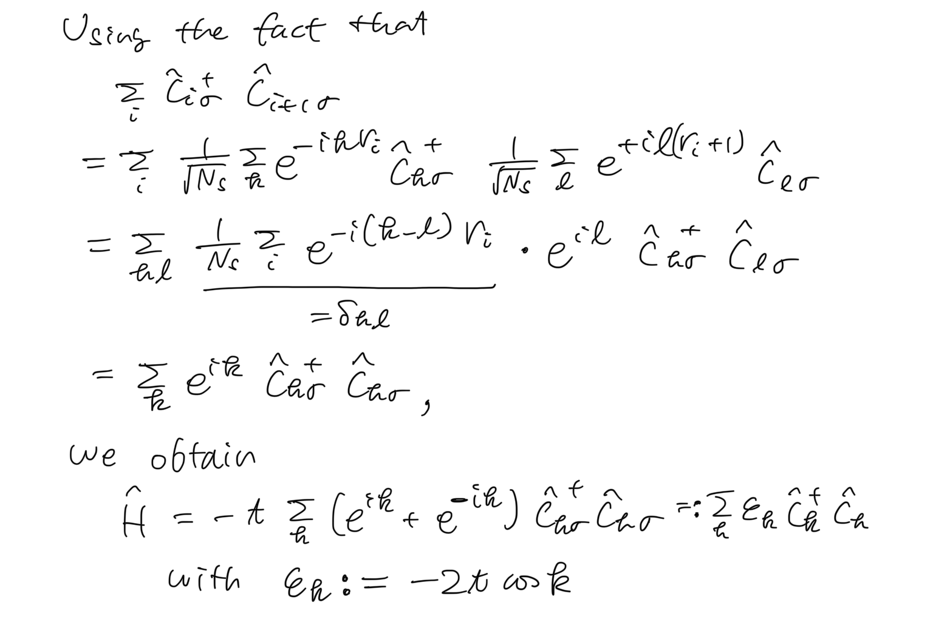
Noninteracting limit (U=0)

Slide 23
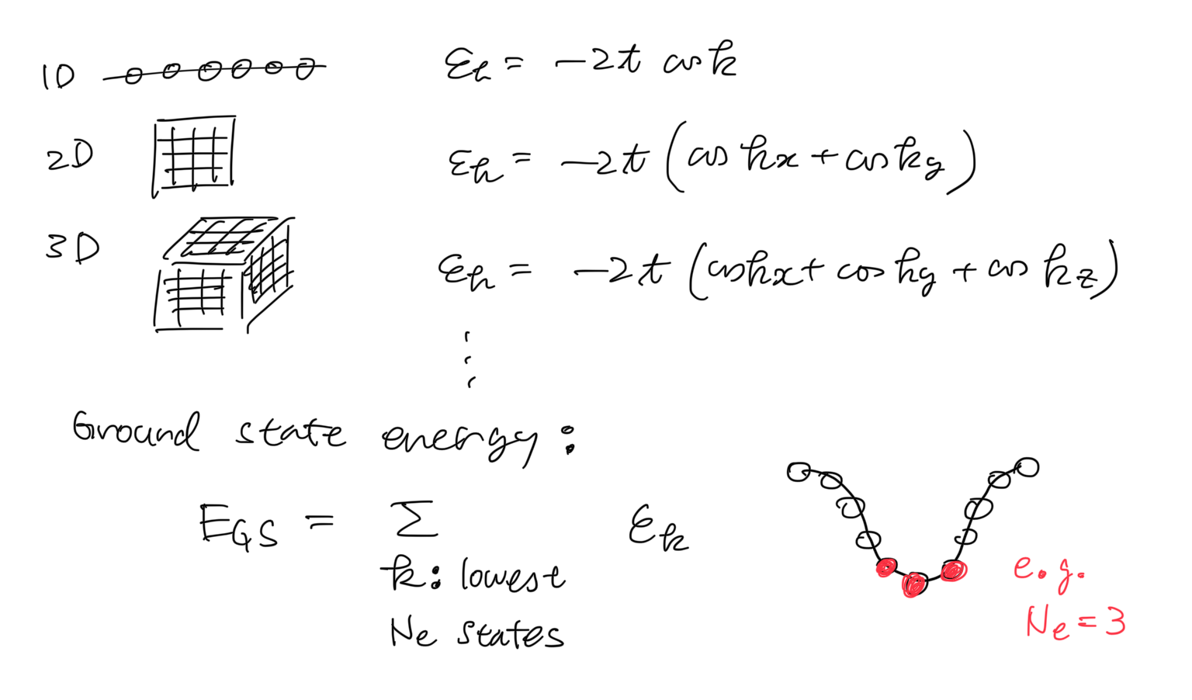
Noninteracting limit (U=0)

Slide 24
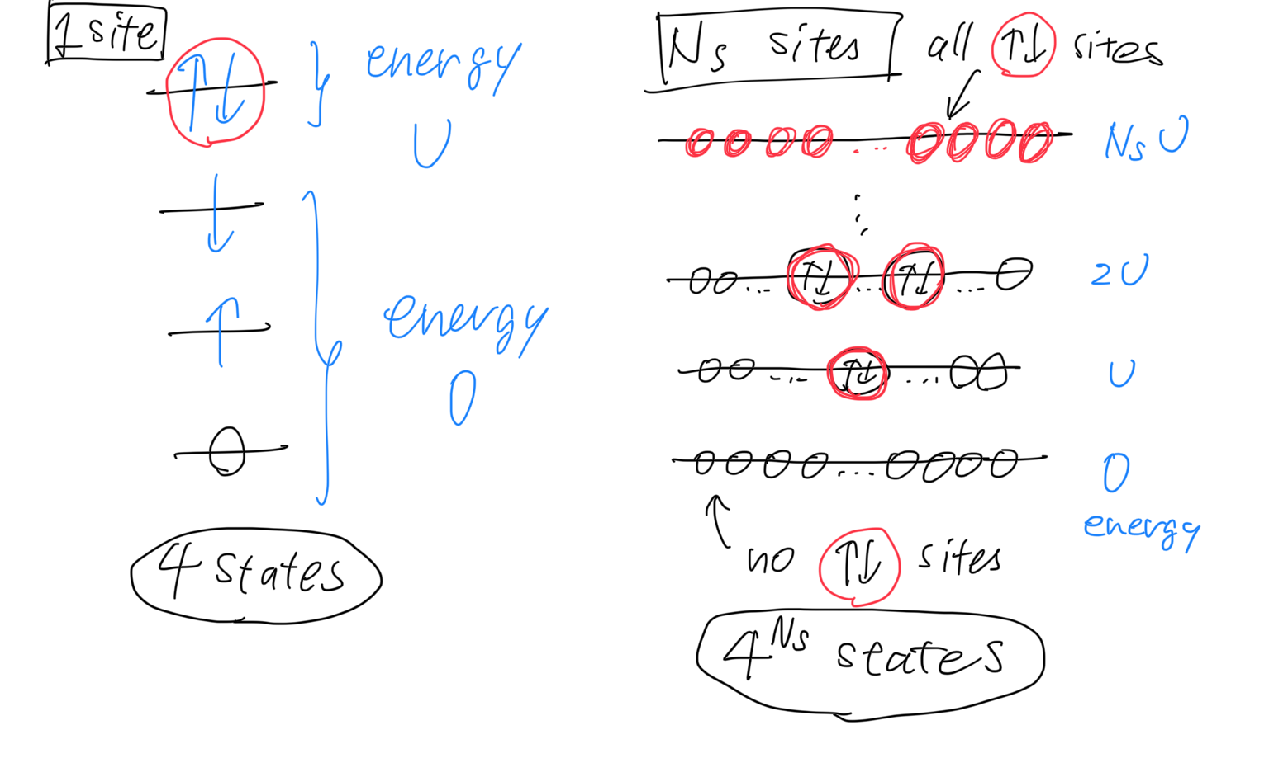
Atomic limit (t=0)

Slide 25
Several limits / Solve by approximation
U=0 limit (noninteracting limit)
Tight-bonding model, free fermion system
t=0 limit
Atomic limit
Mean-field approximation
Antiferromagnetic order for bipartite lattices
2-site model
Relation to the spin model (Heisenberg model)

Slide 26
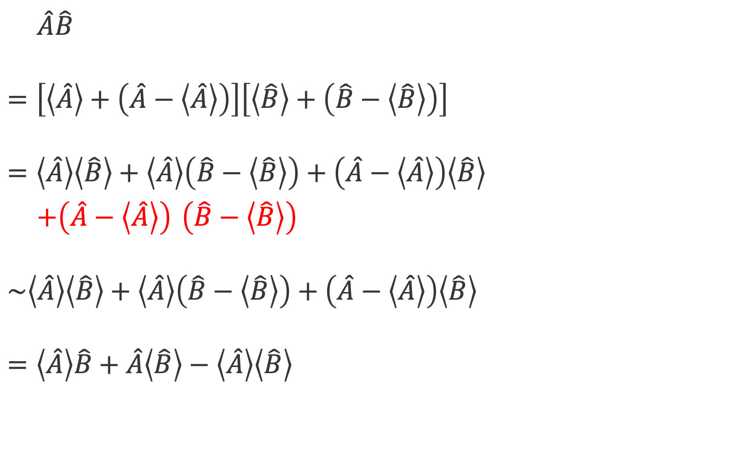
Mean-field (MF) approximation
$\hat{A}\hat{B}$
$$=\left[\left\langle \hat{A}\right\rangle +\left(\hat{A}−\left\langle \hat{A}\right\rangle \right)\right]\left[\left\langle \hat{B}\right\rangle +\left(\hat{B}−\left\langle \hat{B}\right\rangle \right)\right]$$
$$=\left\langle \hat{A}\right\rangle \left\langle \hat{B}\right\rangle +\left\langle \hat{A}\right\rangle \left(\hat{B}−\left\langle \hat{B}\right\rangle \right)+\left(\hat{A}−\left\langle \hat{A}\right\rangle \right)\left\langle \hat{B}\right\rangle$$
$+\left(\hat{A}−\left\langle \hat{A}\right\rangle \right)$ $\left(\hat{B}−\left\langle \hat{B}\right\rangle \right)$
$$\sim \left\langle \hat{A}\right\rangle \left\langle \hat{B}\right\rangle +\left\langle \hat{A}\right\rangle \left(\hat{B}−\left\langle \hat{B}\right\rangle \right)+\left(\hat{A}−\left\langle \hat{A}\right\rangle \right)\left\langle \hat{B}\right\rangle$$
$$=\left\langle \hat{A}\right\rangle \hat{B}+\hat{A}\left\langle \hat{B}\right\rangle −\left\langle \hat{A}\right\rangle \left\langle \hat{B}\right\rangle$$
Throw away fluctuations!

Slide 27
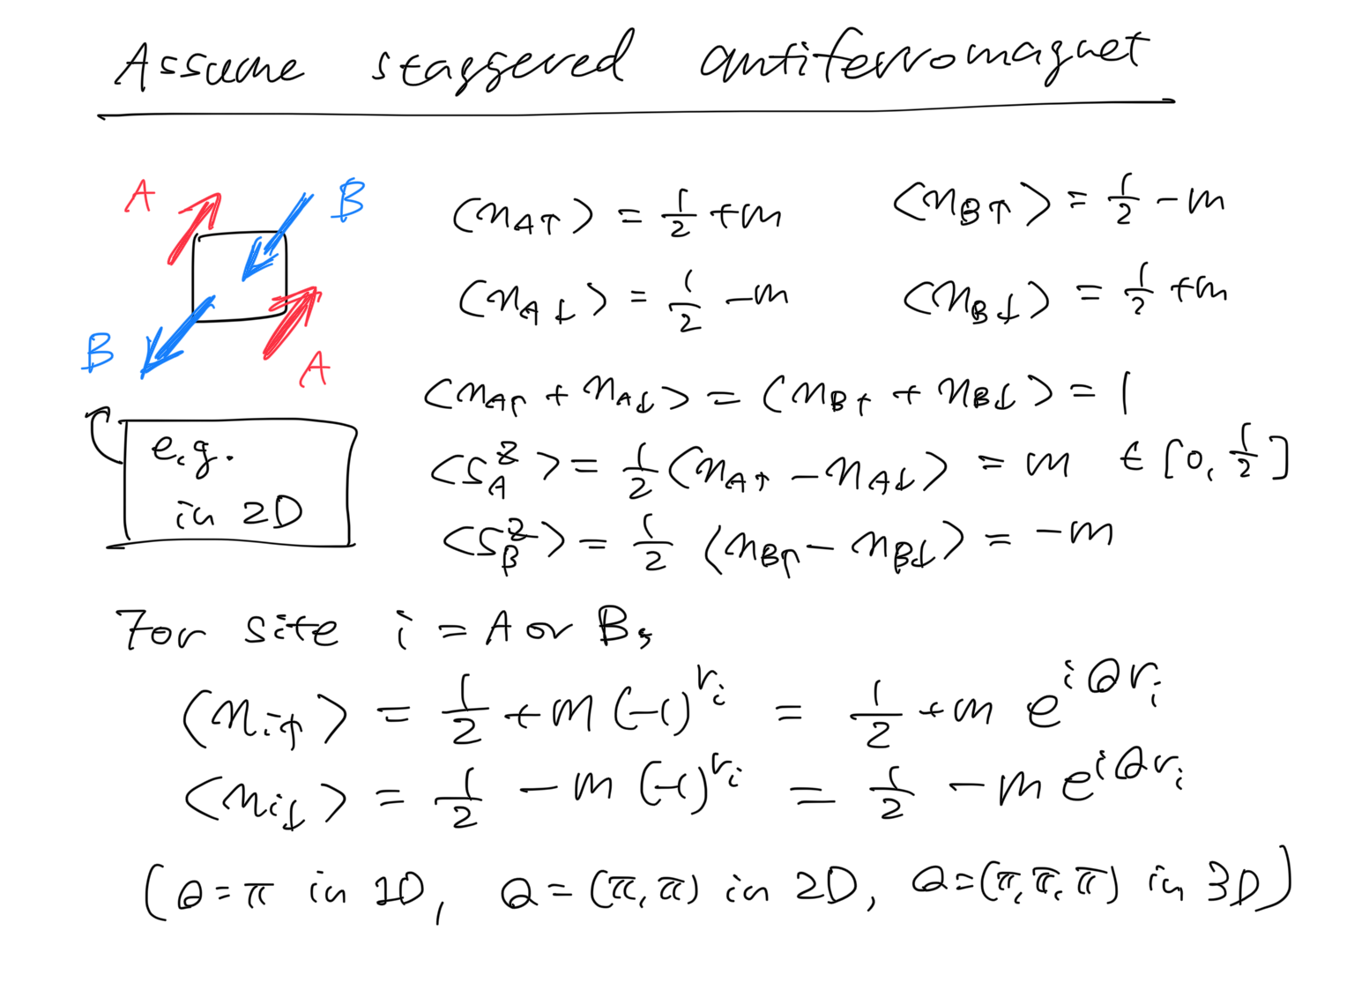
Mean-field (MF) approximation
Focus on the case
Number of sites N_{s} = Number of electrons N_{e}
Often called “half filling” (because N↑=N↓=N_{s}/2)
For hypercubic lattices (chain, square, cube, …), the ground state can be calculated (numerically exactly), and it shows
Apply MF approx. to check antiferromagnetism
long-range antiferromagnetic order for 2D, 3D, 4D, …
quasi-long-range antiferromagnetic order for 1D

Slide 28
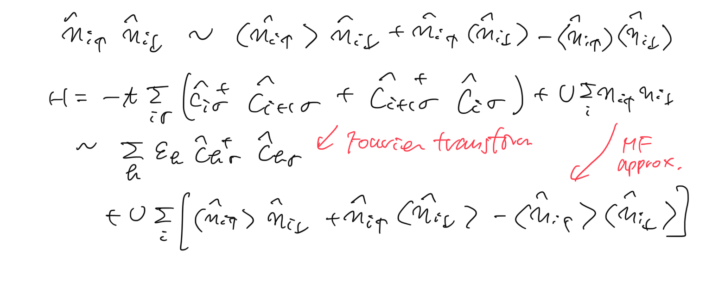
Mean-field (MF) approximation

Slide 29
Mean-field (MF) approximation

Slide 30
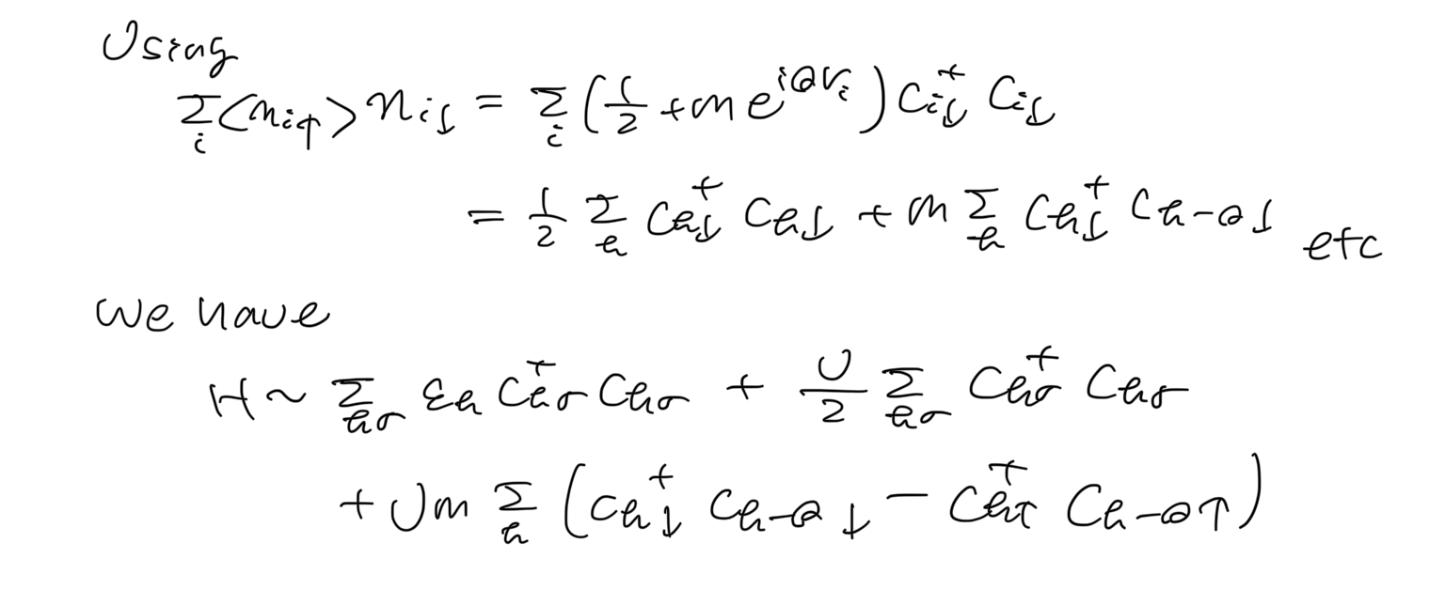
Mean-field (MF) approximation

Slide 31
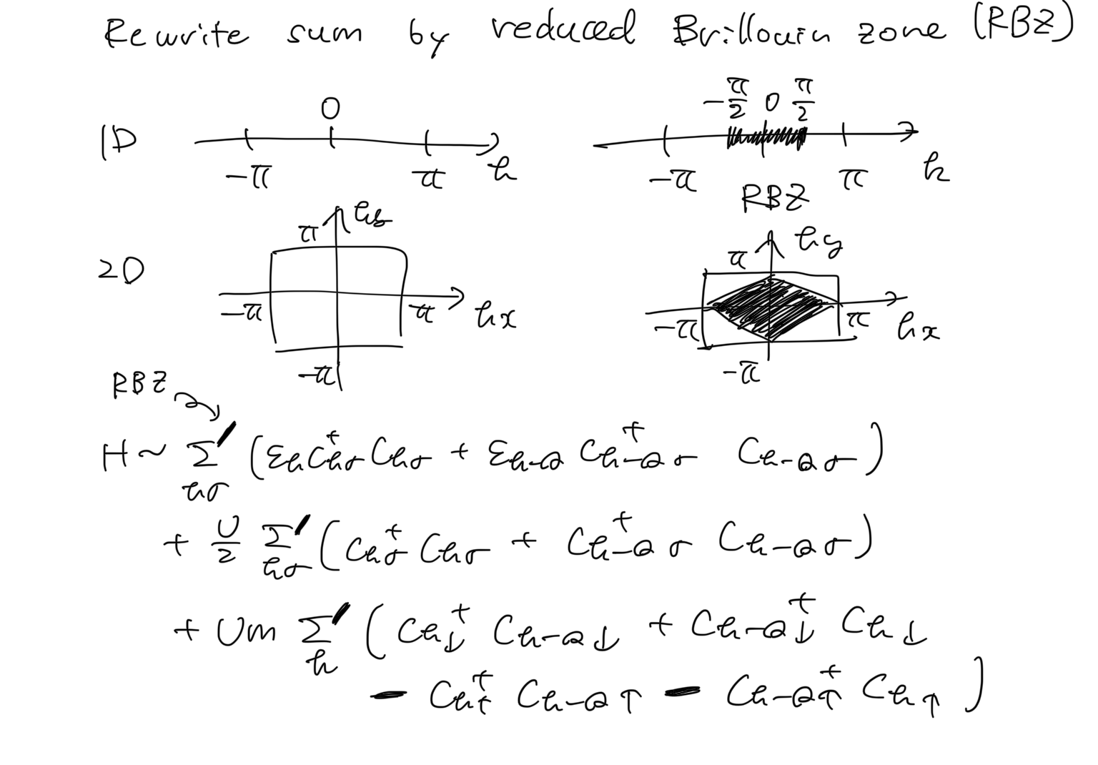
Mean-field (MF) approximation

Slide 32
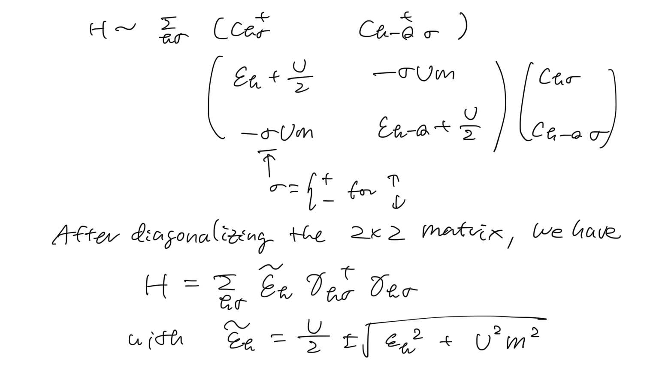
Mean-field (MF) approximation

Slide 33
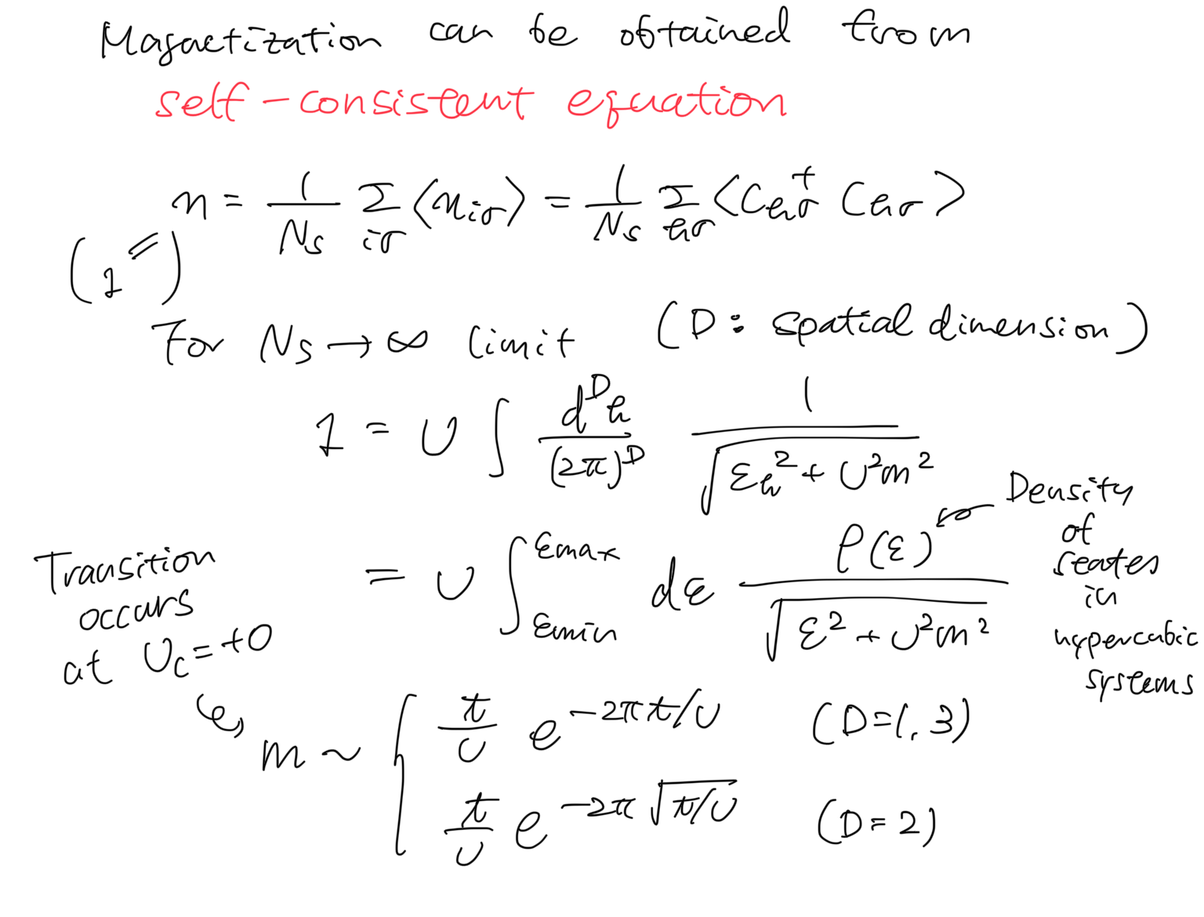
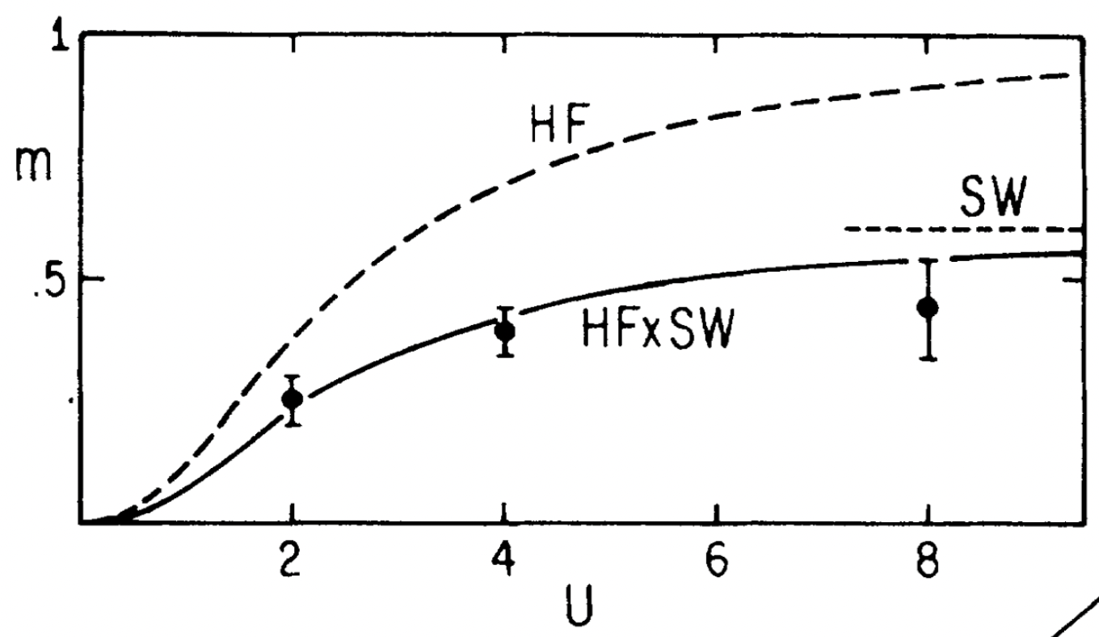
Mean-field (MF) approximation
Mean-field
U_{c}=0
Numerically exact
(quantum Monte Carlo)
J. E. Hirsch, PRB.31.4403(‘85)
J. E. Hirsch and S. Tang, PRL.62.591(‘88)

Slide 34
Several limits / Solve by approximation
U=0 limit (noninteracting limit)
Tight-bonding model, free fermion system
t=0 limit
Atomic limit
Mean-field approximation
Antiferromagnetic order for bipartite lattices
2-site model
Relation to the spin model (Heisenberg model)

Slide 35
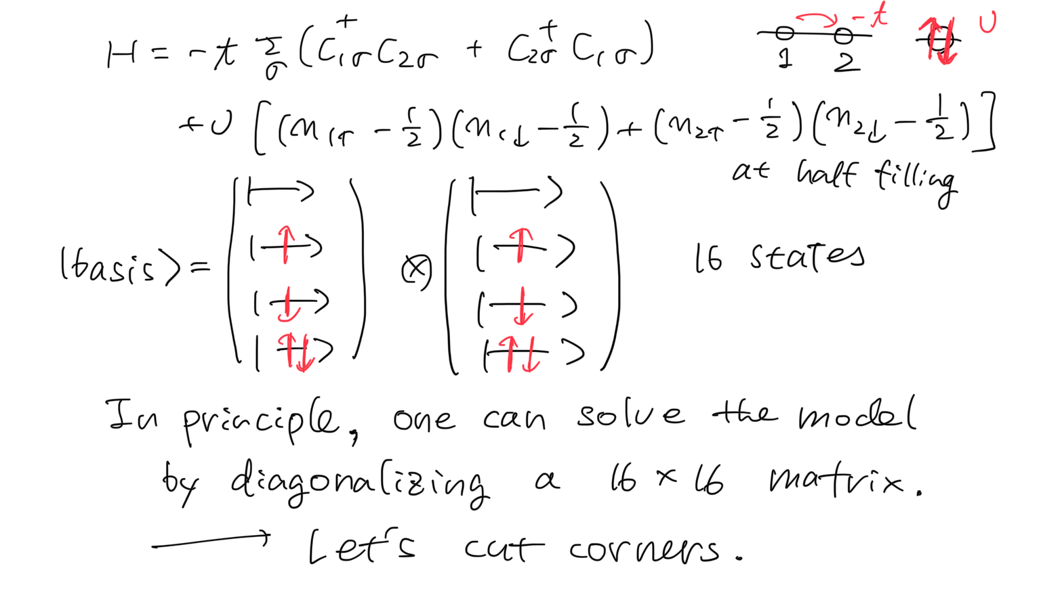
2-site Hubbard model

Slide 36
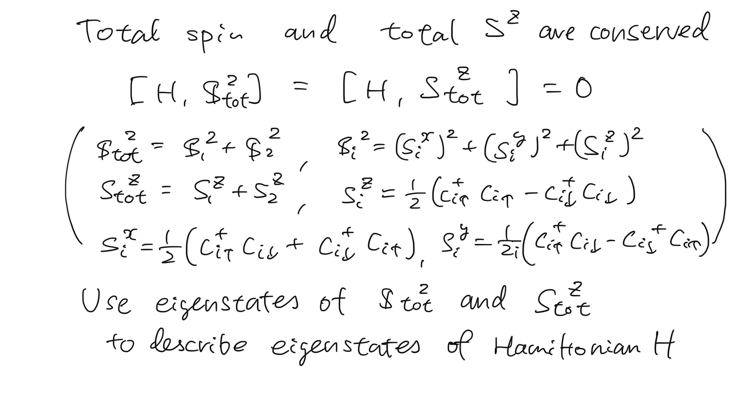
2-site Hubbard model

Slide 37
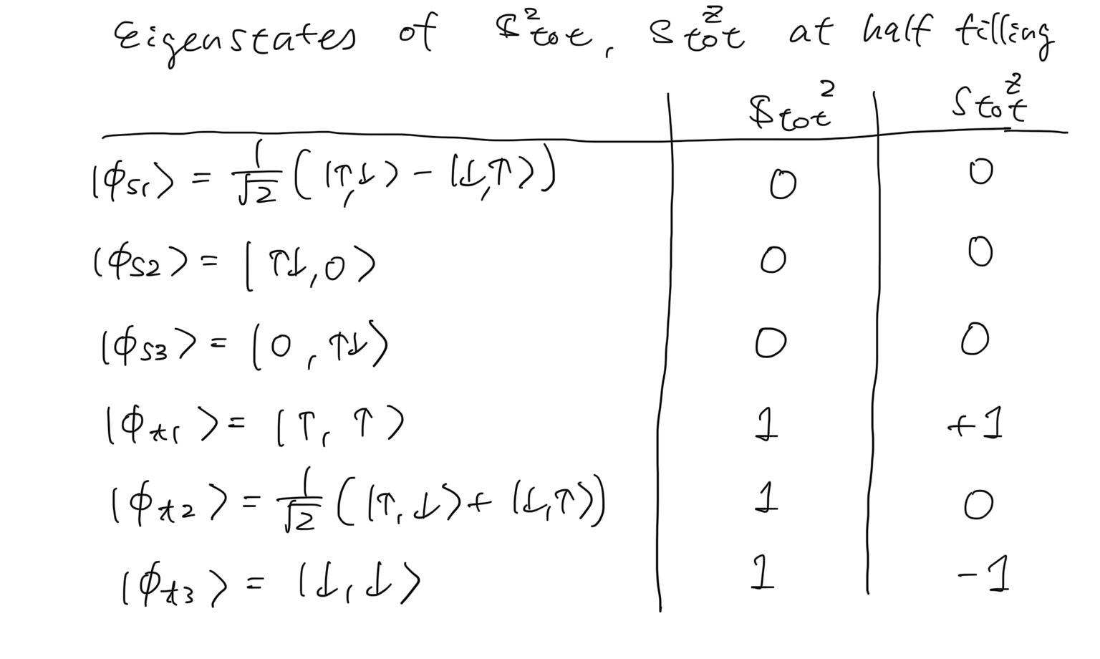
2-site Hubbard model

Slide 38
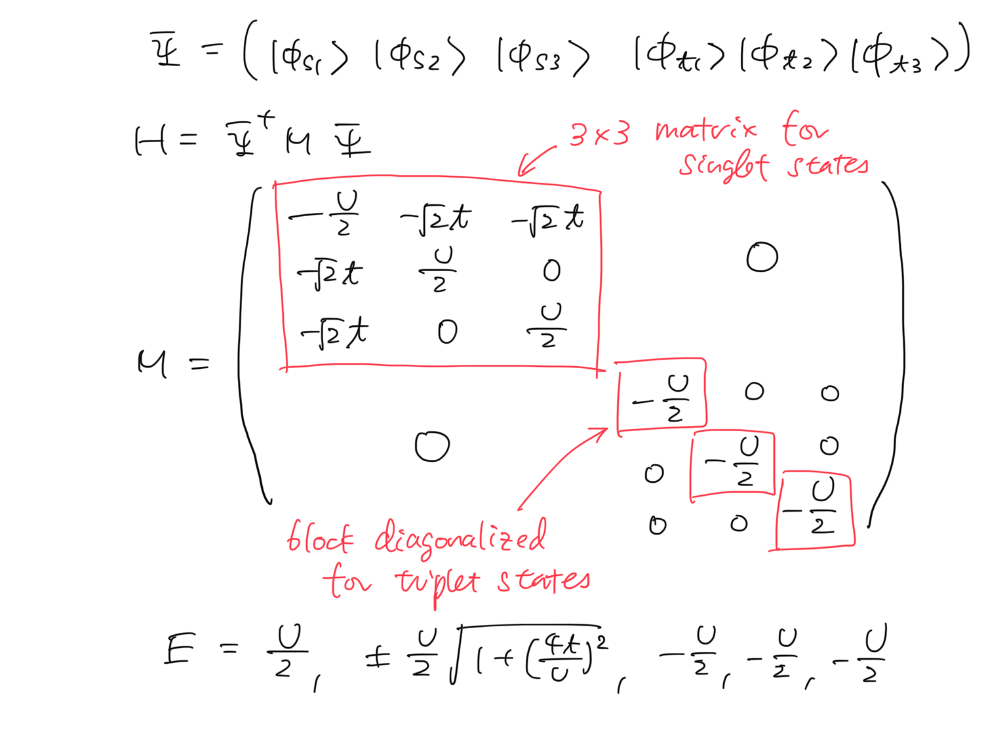
2-site Hubbard model

Slide 39
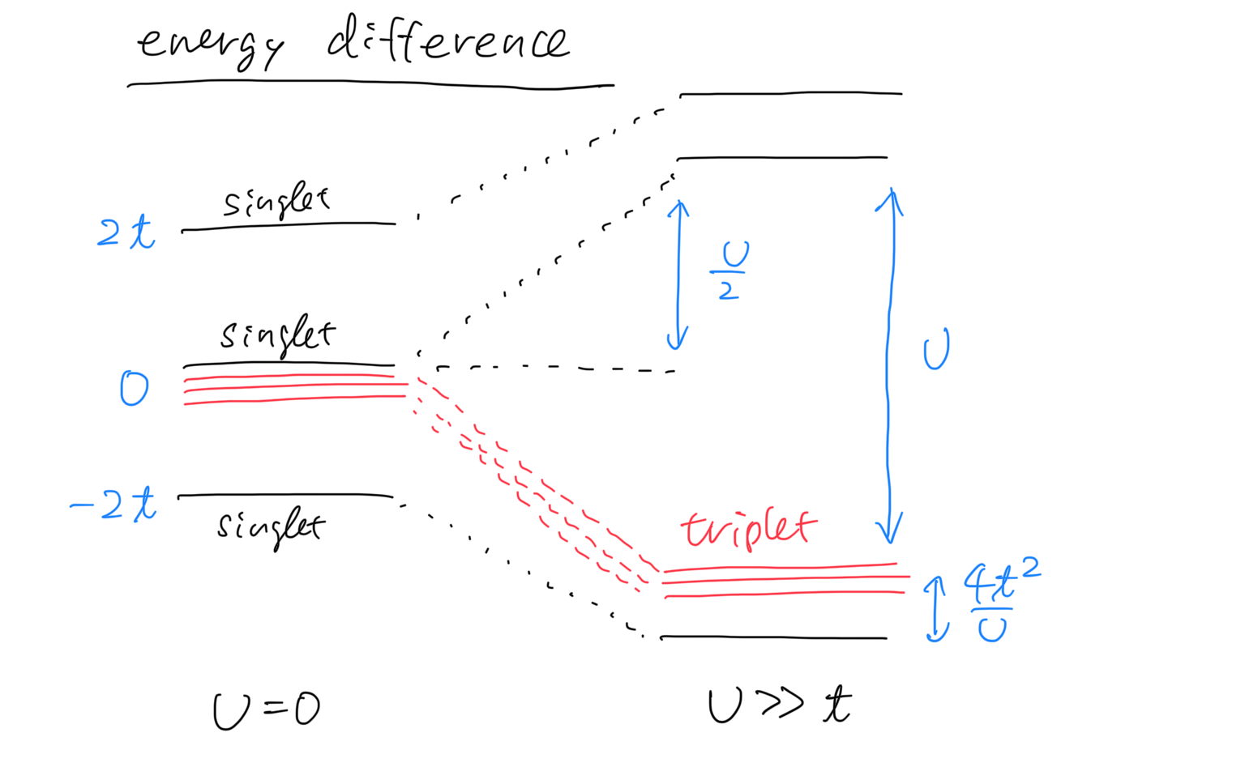
2-site Hubbard model

Slide 40
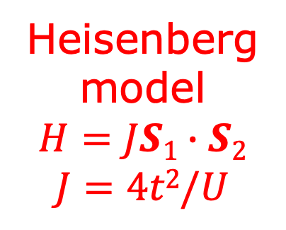
2-site Hubbard model
Heisenberg
model
$$H=JS1∙S2$$
$$J=4t2/U$$

Slide 41
Today’s summary
Brief review of itinerant electron systems
Electrons in crystals
Second quantization
Hubbard models
Solving models for simple cases
Noninteracting and atomic limits
Mean-field approximation
Exact diagonalization (2 sites)
→ Strong coupling limit: Heisenberg model (spin system)
Magnetism and quantum spin liquid
Spin models
Frustrated magnetism and quantum spin liquid
Kitaev honeycomb spin liquid

